Slide 1
HSP Guidance used in cancer assay for precision medicine
Department of Pathology, Molecular Unit, Herlev Hospital
6th of April 2017

Slide 2
AGENDA
HSP Guidance used in cancer assay for precision medicine
What is precision medicine
FISH
DNA
Results
Conclusion

Slide 3
What is Precision Medicine?
Cancer is a genetic disease, caused by certain changes to genes that control the way our cells function.
Cancer is not a single disease, but a group of diseases that pathologists can classify into more than 120 identifiable types.
Previously a patient treatment plan was typically chosen after assessing three basic criteria: the specific type, classification, and stage of the patient’s cancer. After this “one-size-fits-all” medicine prescribed.
Notes:
Pathologist are specialized medical doctors that are trained in looking at normal and turmor tissue, blood and other biological fluids to identify abnormal behavor of the celles

Slide 4
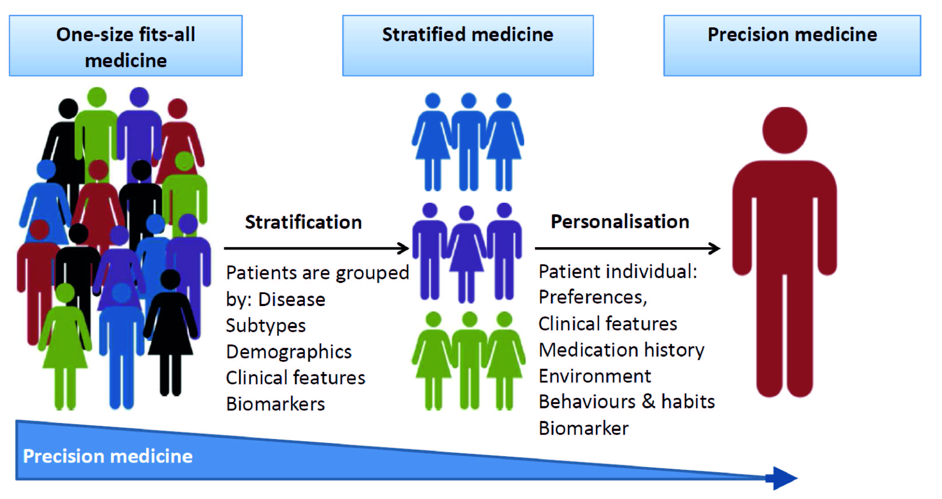
What is Precision Medicine?

Slide 5
What is Precision Medicine?
Precision medicine is based upon the scientific understanding of “biomarkers,” especially that the DNA (deoxyribonucleic acid) in the genome is unique to each individual and that alternations/mutations in the DNA of genes can lead to cancer.
These changes often lead to a measurable biomarker.
One of the most promising uses of biomarkers is to help identify which therapies a patient’s cancer may or may not respond to. This approach is referred to as molecular profiling.

Slide 6
What is Precision Medicine?
There are many molecular profiling methods for detecting alterations in biomarkers that may drive a patient’s cancer, some are below.
Immunohistochemistry (IHC) is a test that determines the level of protein expression in a tumor sample.
Fluorescence in situ hybridization (FISH) provides the ability to determine gain or loss of a gene.
Next-generation sequencing (NGS) allows sequencing of the entire human genome for mutations.

Slide 7
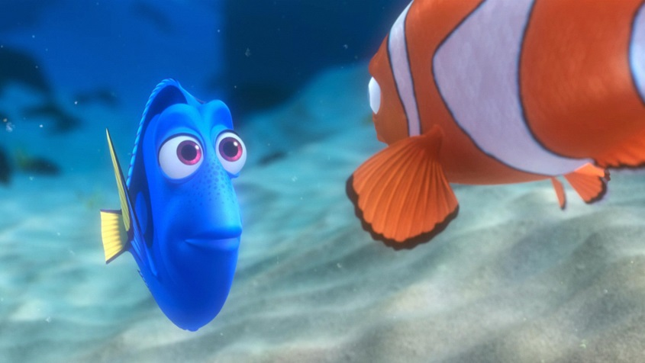
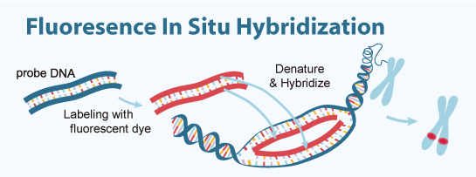
Cancer assay, Fluoresence in situ hybridization (FISH)
FISH is a molecular technique used to visualize chromosomal aberration.
e.g. measure the gene copy number of ERBB2. Patients with excess of the HER2 protein have a benefit of treatment with anti-HER2 drug.

Slide 8
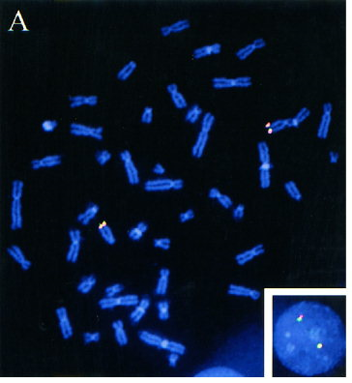
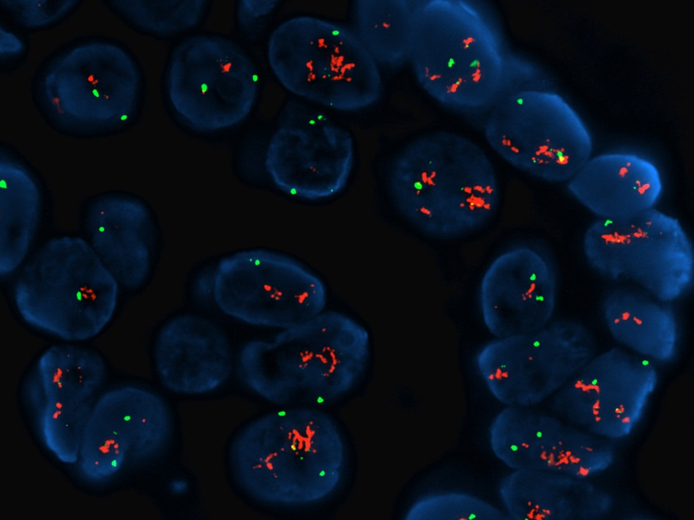
Standard FISH
Disadvantage: Assay time: 16 hours
Toxic reagent: Formamide
Normal cell Cancer cell
Notes:
However we desided to try to exchange the toxic formamide, that have been the solvent of choice in FISH for lowering the melting point.

Slide 9
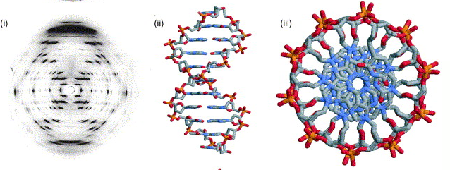
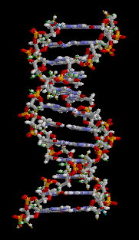
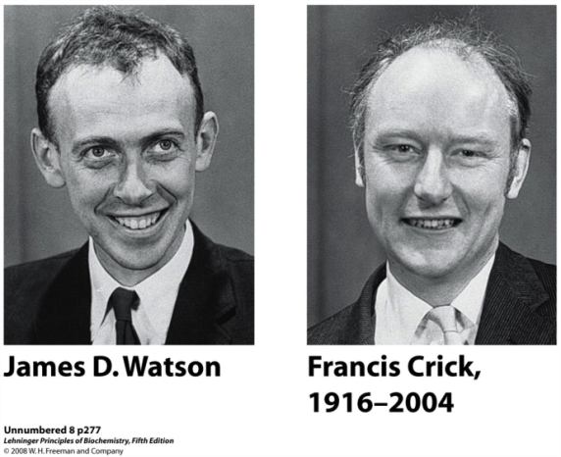
Watson and Crick double helix
The stacking of base pairs stabilizes the double helix by the hydrophobic effect and conformation of the ring systems, together with the hydrogen bonding between bases.
Notes:
I will spare you all the talk about London dispersion forces, van der Waals forces and pi-electron systems of the aromatic bases

Slide 10
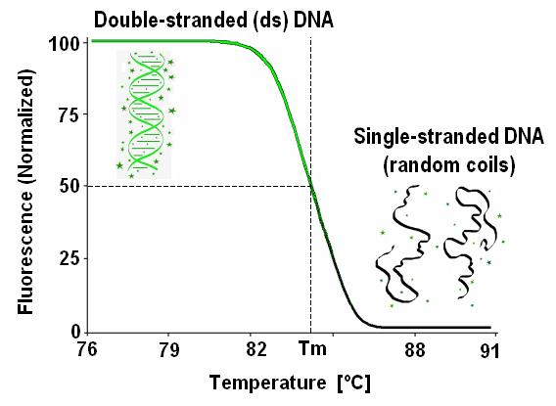
The effect of heating on DNA
Since the sugar and phosphate backbone of DNA are common to all the nucleosides, the specificity must be on the pyrimidine and purine bases

Slide 11
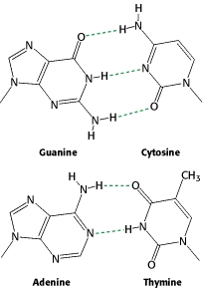
Base pairing
The double helix can be disrupted by heating of DNA. The heating disrupts the hydrogen bonds between base pairs and thereby causes the strands to separate. The dissociation of the double helix is often called denaturation/melting. However heating destroy cell morphology.
Notes:
Lower the melting temperture by 0,6 – 0,73 grader/% FA. 45% FA * 0,65 = 29 grader

Slide 12
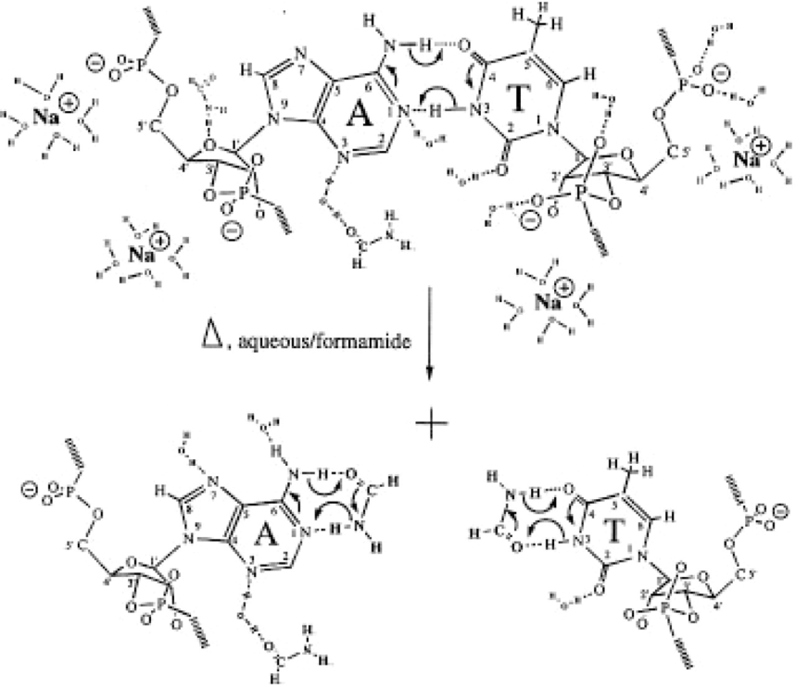
Effects of Formamide on DNA Stability
To preserve sample morphology, the traditional FISH assay uses formamide to lower the Tm, by formamidation of the bases.
To substitute for formamide we used HSP to identify suitable candidates.
Stabilization of the coil state by ‘formamidation’ of the Watson-Crick binding sites of the bases. The model includes the potential enhancement of hydrogen bonding through resonance-assistance between base pairs as well as between bases and formamide. Nucleic Acids Res. 1996;24(11):2095-2103.

Slide 13
HSP Correlation for DNA
The HSP for DNA was estimated from melting point data for different solvents found in the literature.
Solvent | δ_{D} | δ_{P} | δ_{H}
DNA | 19.0 | 20.0 | 11.0
Guanine | 20.0 | 12.7 | 12.5
Cytosine | 19.5 | 12.1 | 9.9
Adenine | 20.0 | 10.2 | 13.7
Thymine | 19.5 | 14.2 | 12.6
Average | 19.75 | 12.3 | 12.2

Slide 14
Hydrogen bonding
The cohesive energy derived from hydrogen bonding is only about 14% of the total.
DNA Molecular stacking represent π/π interactions between molecules.
RESULT (MPa^{½})
δ²_{D} δ²_{P} δ²_{H}
19.0 20.0 11.0
E_{H} is 14% of E

Slide 15
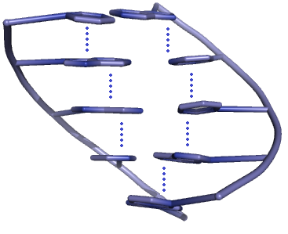
Base stacking
The individual bases form strong stacking interactions which are major contributors to duplex stability. Base-stacking interactions are hydrophobic and electrostatic in nature, and depend on the aromaticity of the bases and their dipole moments.

Slide 16
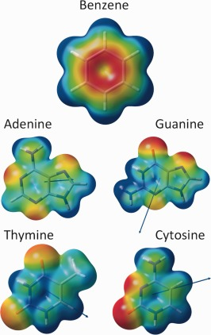
What type of solvents could be interesting
Starting with a initial HSP sphere estimate, and taking into account the electrostatic potential surface (EPC), dipole moment, size of solvents. The solvent Sulfolane was on the list.
Electrostatic potential surface (EPS)
and dipole moment (blue arrow)

Slide 17
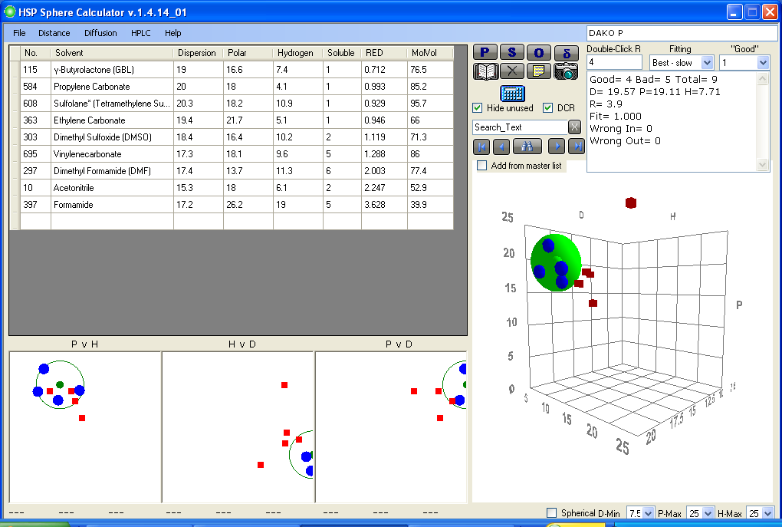
What works best?
Cyclic Polar Aprotic solvents work, they also give perfect HSP sphere.
A interest pattern emerged regarding the functional groups.

Slide 18
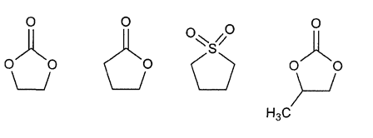
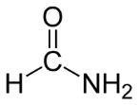
Potential Formamide replacements
During testing of the different solvents a striking feature appeared.
The hybridization time could be lowered from 14 hours to 30 minutes without affecting the cancer assay.
formamide
ethylene
carbonate
γ-butyro
lactone
sulfolane
propylene
carbonate
Signal intensity | ½ | 3 | 3 | 3 | 3
Background staning | ½ | ½ | ½ | ½ | ½

Slide 19
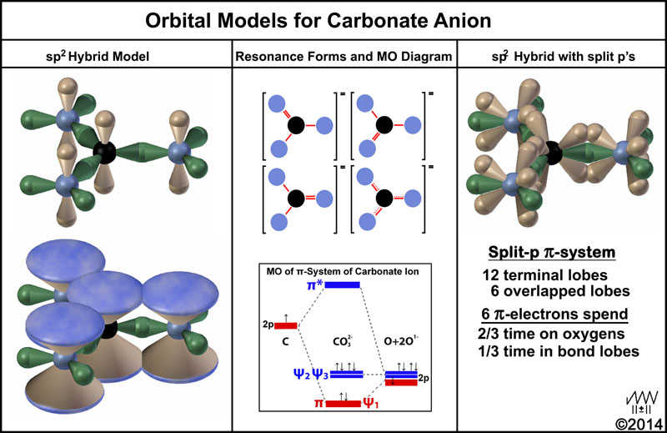
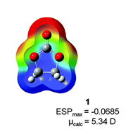
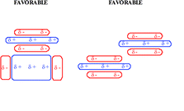
Ethylene carbonate
Ethylene carbonate (EC) can break the stacking of DNA. At room temperature ethylene carbonate is a transparent crystalline solid with m.p of 34-37○C, and can be mixed with water.
Solvent | δ_{D} | δ_{P} | δ_{H}
DNA | 19.0 | 20.0 | 11.0
50/50 EC/H₂O | 18.7 | 19.3 | 11.0

Slide 20
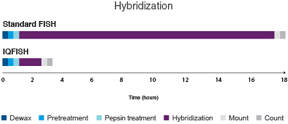
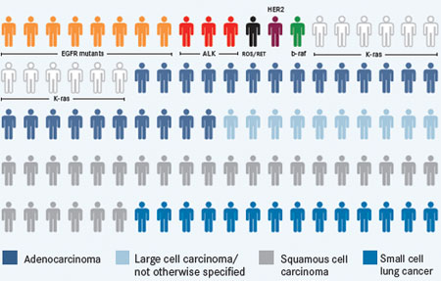
Ethylene carbonate in cancer assay
FISH is used in clinical settings to detect if a patient benefits from anti-HER2 treatment. The cancer test is required before a treatment can be initiated.

Slide 21
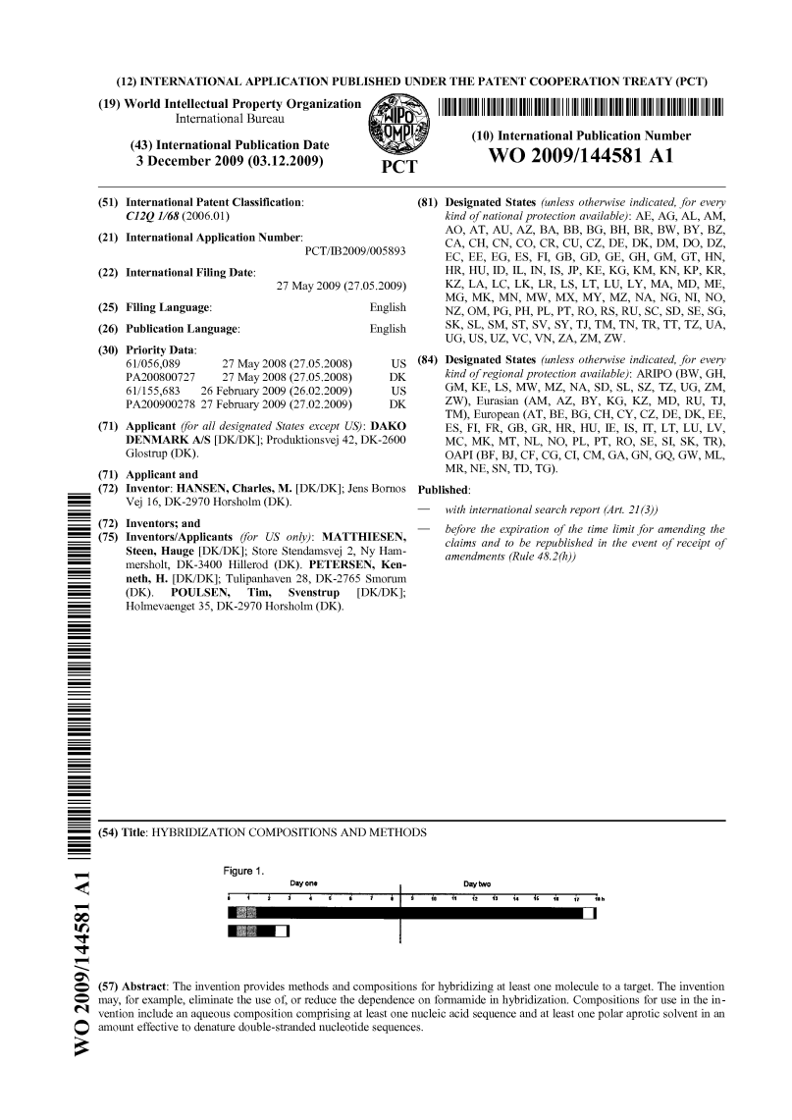
Ethylene Carbonate replaces Formamide for Rapid, Safe Hybridization

Slide 22
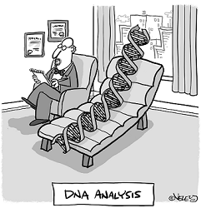
DNA holds the key for future treatments

Slide 23
QUESTIONS

